Slide 1
MultiPDF Chat App: A Reasoning-Based LLM System
Student Name: Prachi Pravin Karande
Department: Computer Engineering
Class: TE Div: A
College: DYPIEMR

Slide 2
Problem Selection
Goal: Propose and develop a unique project that showcases reasoning and system-2 thinking in LLMs.
Define the problem and identify how reasoning is critical to the solution.
Design a system architecture that integrates LLMs with external tools if needed (e.g., databases, solvers).
Problem Definition
Challenge: Important information is often buried in large PDF files, making manual extraction tedious.
Objective: Create a streamlined application for processing PDFs and facilitating conversational interactions.

Slide 3
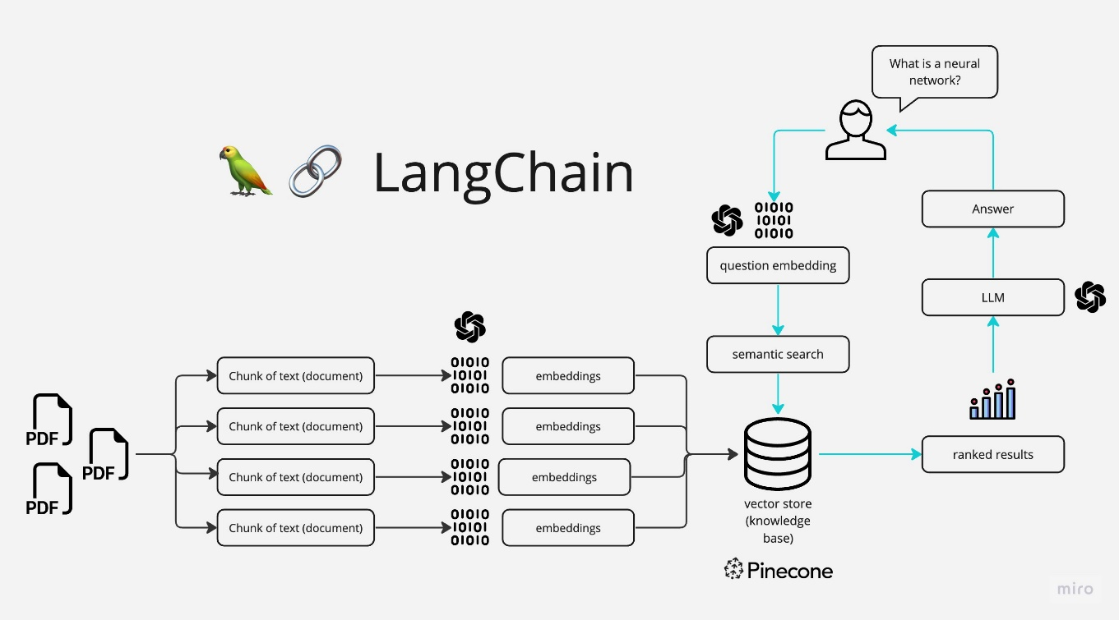
System Architecture :

Slide 4
Methodology:
PDF Loading: Extract text from multiple PDFs.
Text Chunking: Divide text into smaller, manageable chunks.
Language Model Utilization: Generate vector representations (embeddings) of text chunks.
Similarity Matching: Identify semantically similar text chunks based on user queries.
Response Generation: Create context-aware responses using selected text chunks.

Slide 5
System Design:
Frontend: Implemented using Streamlit for an interactive user interface.
Backend Components:
Text Extraction: PyPDF2 for text extraction.
Text Chunking: LangChain's CharacterTextSplitter for chunking where the chunk_size=1000. Overlapping chunks ensure no context loss during retrieval & is chunk_overlap=200.
Embeddings: Hugging Face’s hkunlp/instructor-xl for vector embeddings. FAISS is used to store and retrieve embeddings efficiently based on user queries.
Conversational Model: Hugging Face’s google/flan-t5-base for generating responses.
State Management: Streamlit’s session state for maintaining chat history.

Slide 6
Reasoning-Based System Analysis:
Contextual Understanding: Matches user queries with relevant document content using embeddings.
Conversational Interaction: Combines LLM reasoning with retrieved information for coherent responses.
Inference and Explanation: Generates explanatory responses demonstrating reasoning capabilities.
Memory-Driven Logic: Utilizes ConversationBufferMemory to track interaction history.

Slide 7
System 2 Thinking Evaluation:
Deliberate Reasoning: Retrieves relevant information and formulates coherent responses logically.
Effortful Problem Solving: Analyzes input queries and matches them to document content effectively.
Memory Utilization: Maintains context awareness through prior inputs, enhancing deliberation.

Slide 8
Importance of LLM in this project:
Definition:
A Large Language Model (LLM) is an advanced AI system trained on vast amounts of text data to understand and generate human-like text. It uses deep learning techniques, particularly transformers, to process and generate language.
Capabilities:
Natural Language Understanding: LLMs can understand user queries in various formats, including casual, formal, and technical language.
Text Generation: They can produce coherent and contextually relevant text, simulating human-like conversation or explanations.
Reasoning and Inference: Advanced LLMs can infer meaning, draw conclusions, and provide reasoning-based answers to complex queries.

Slide 9
Importance of API Keys in the Project:
Service Access: Allows secure access to external APIs like Hugging Face or OpenAI for embeddings and model services.
Authentication: Ensures only authorized applications can use the API functionalities.
Integration: Facilitates seamless use of advanced AI models and embeddings in the project.
Cost Control: Helps monitor and manage usage costs through linked API tiers.
Scalability: Enables access to additional features and higher limits as needed.
Security: Safeguards sensitive resources by managing API keys securely using tools like dotenv.

Slide 10
Results and Performance Analysis:
Accuracy: The application demonstrates a high degree of accuracy in retrieving relevant chunks of text and generating coherent responses.
Efficiency: Text processing and vectorization occur in a reasonable timeframe, ensuring smooth user experience.
User Feedback: Positive feedback on the ease of use and clarity of responses.
Limitations: Performance may degrade with extremely large PDFs or complex queries.
Future Scope and Improvements:
OCR Integration: Incorporate OCR capabilities to handle image-based PDFs.
Multi-Language Support: Expand support for multilingual documents using multilingual embeddings.

